Slide 1

KnightCop
Group 11
Elean Atencio CpE
Nitin Kundra CpE

Slide 2
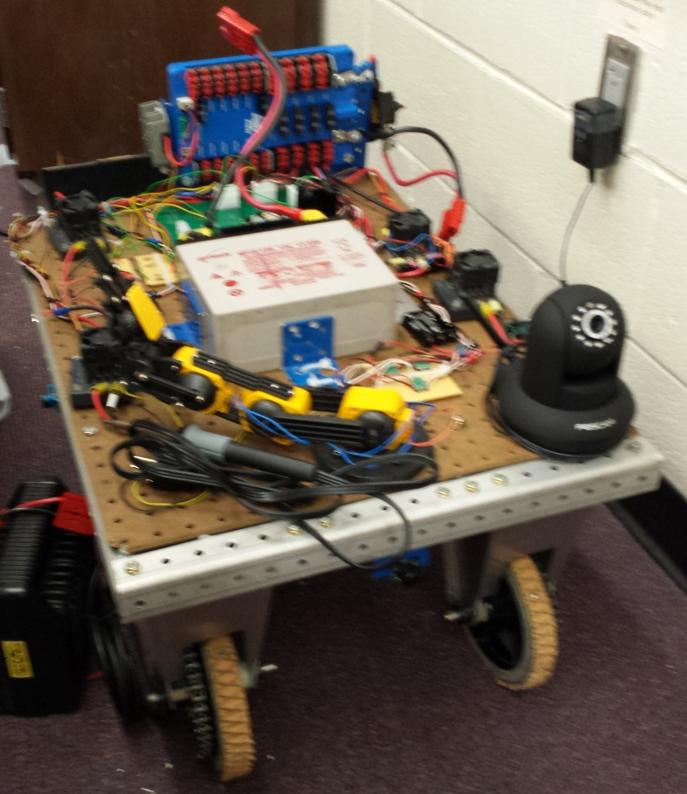
The Project
Remote controlled scout robot to aid police in hazardous situations
Onboard manipulator arm for interacting with objects
Environment sensors
Video feedback
PC and Phone UI

Slide 3
Goals and Objectives
Navigate across urban terrain
Wireless control and data transmission (Video + sensors + Motor Control)
Prefer dexterity (degrees of freedom) over strength in robot arm
Intuitive UI
Reliable and robust

Slide 4
Specifications
Max Dimensions | l x b x h | 30 x 30 x 30 in
Operating Range |  | 50 m
Power Supply Voltage |  | 12 V
Minimum Speed |  | 1 m/s
Max Robot Weight |  | 50 kg
Video Feed | 30 fps | 640 x 480 px
Arm | Lifting Capacity | 100 g
 | Rotation Span | 120°

Slide 5
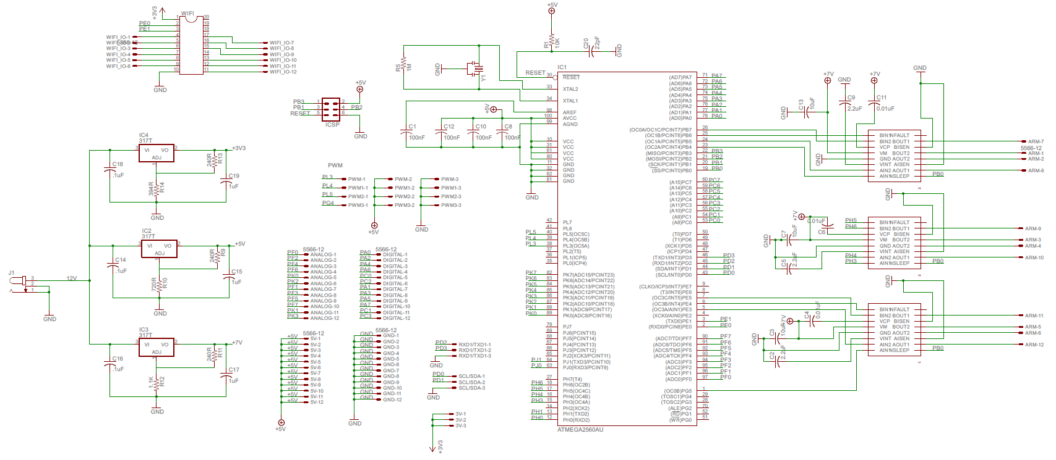
Robot Schematic

Slide 6
Hardware Block Diagram
User Interface
Robot
ENVIROMENT
Ambient Light
Wifi T/R
Battery Level
Temperature
Android
Phone
MCU
ARM
Laptop
Power
Wifi
Router
Motor Control
Chassis
Integrated Wifi
Obstacle
Detection
Pan & Tilt
Cam
Night
Vision
Video Feedback
Motor Control
Elean
Nitin

Slide 7
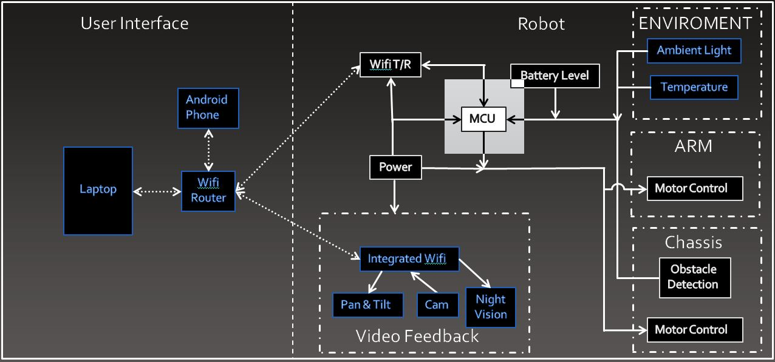
Microcontroller

Slide 8
Microcontroller
 | MSP430G2553 | ATmega328 | ATmega2560 | PIC16F886 | PIC18F47J53
Architecture (bits) | 16 | 8 | 8 | 16 | 8
Frequency (MHz) | 16 | 20 | 16 | 8 | 8
Max Voltage (V) | 3.6 | 5.5 | 5.5 | 5.5 | 3.6
Program Memory (KB) | 16 | 32 | 256 | 14 | 128
RAM (KB) | 0.5 | 2 | 8 | 0.359 | 3.71
USART/SPI | 1/1 | 1/2 | 4/5 | 1/1 | 2/2
I/O Pins | 24 | 23 | 86 | 25 | 44
ADC (channels, bits) | 8, 10 | 8, 10 | 16, 10 | 11, 10 | 13, 12

Slide 9
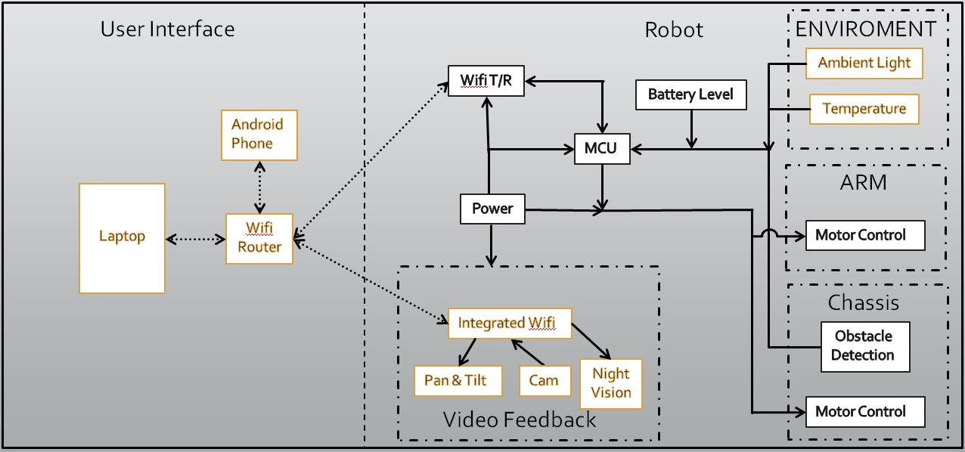
Mobile Base

Slide 10
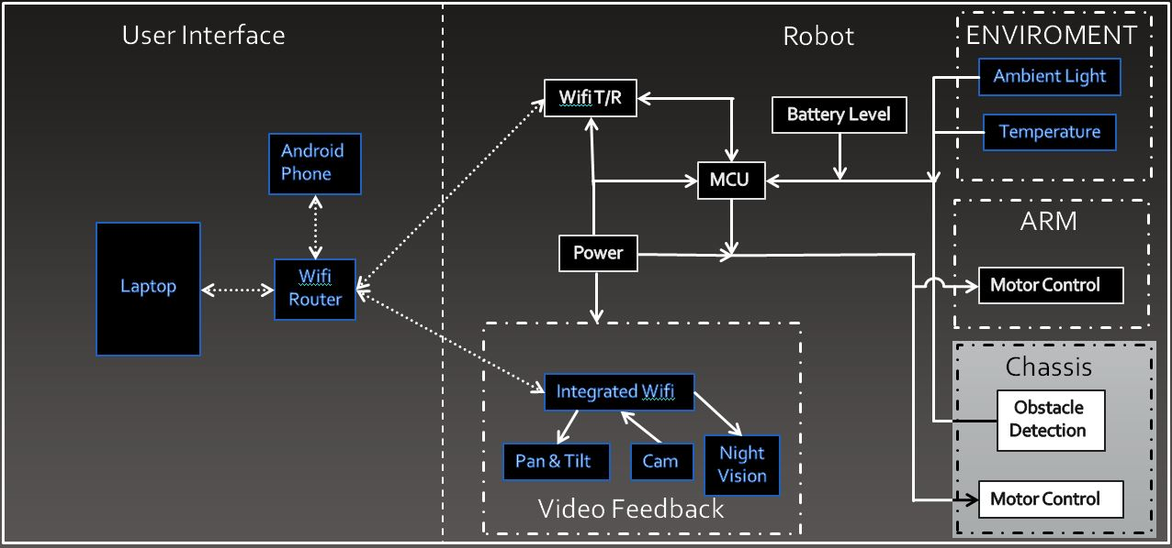
Mobile Base

Slide 11
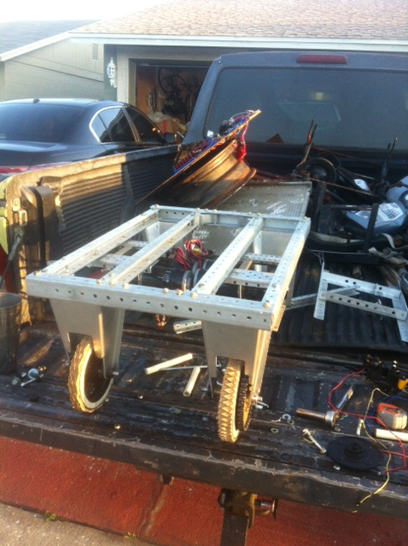
Drive Base
Design and built by us
Footprint: 12”H x 18”W x 25.5”L
Pre-drilled aluminum
6 inch threaded wheels
Gear ratio: 30:1
Tank drive configuration

Slide 12
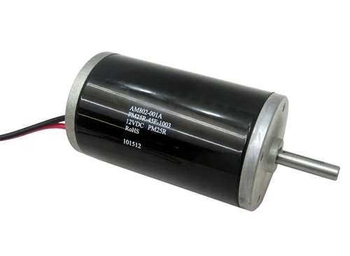
Drive Motors
CIM Motor (AM802-001A)
12V DC Brushed
No Load RPM: 5310
Max Power: 337 W
Footprint: 2.5” diameter, 4.3” long

Slide 13
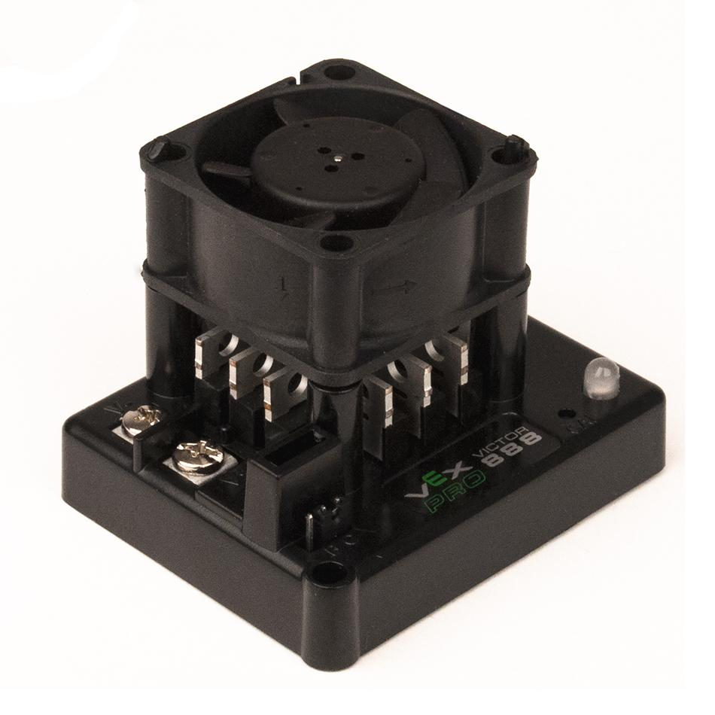
Drive Motor Controllers
Victor 888 Motor Controller
Supply voltage: 6-15 V
Continuous supply current: 60A
Surge supply current: 150A
PWM control
Break and coast modes
Footprint: 2”H x 2.7”W x 2.3”L

Slide 14
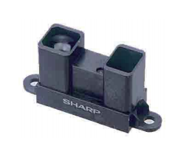
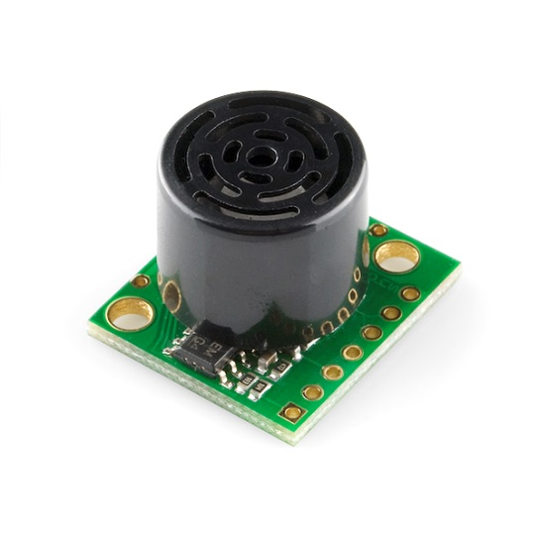
Proximity Technology
Infrared Sensors
  Cheap: $10-$15
  Narrow beam width
  Problems in direct sunlight
Ultrasonic Sensors
  About double the price of infrared
  Poor detection of absorbent materials
  Wider beam width
  Detects items as close as 2 cm

Slide 15
Ultrasonic Sensors
 | Parallax PING))) | HC-SR04 | Maxbotix LV-EZ1 | SRF04
Supply Voltage (V) | 5 | 5 | 2.5-5 | 5
Supply Current (mA) | 30 | 2 | 3 | 30
Range (cm) | 2-300 | 2-50 | 0-645 | 3-300
Frequency (kHz) | 40 kHz | 40 kHz | 42 kHz | 40 kHz
size (mm) | 22x46x16 | 20x43x15 | 20x22x16 | 20x43x17
Price | $29.99 | $5.99 | $29.95 | $29.50
Cascade feature | No | No | Yes | No

Slide 16

Arm System

Slide 17
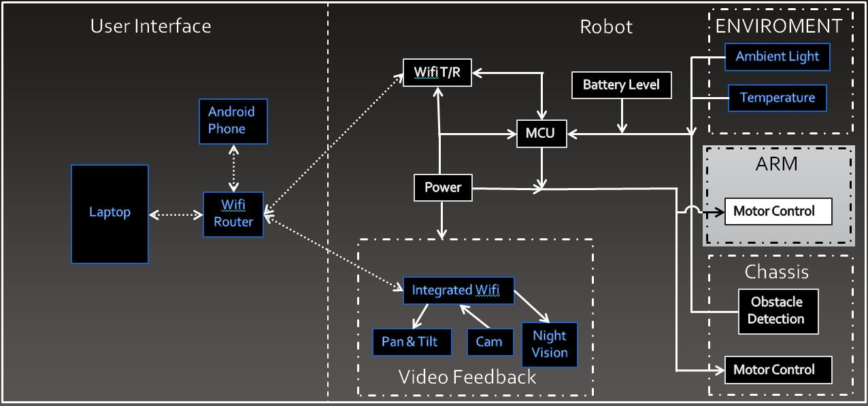
Arm System

Slide 18
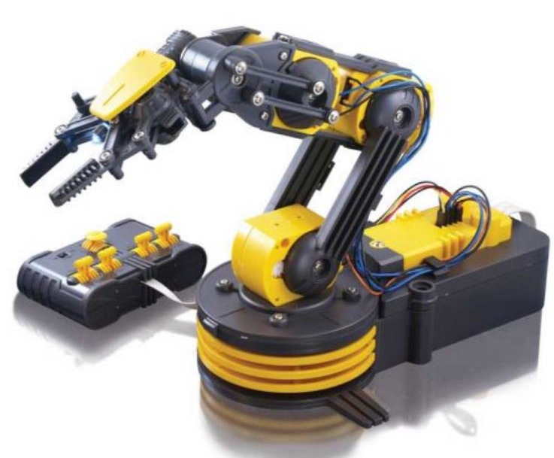
Manipulator
OWI-535 Robotic Arm
Robotic Kit (easier to modify)
9”L x 6”W x 15” H
Lifting capacity 100 gram
5 Degrees of motion
Price: $45

Slide 19
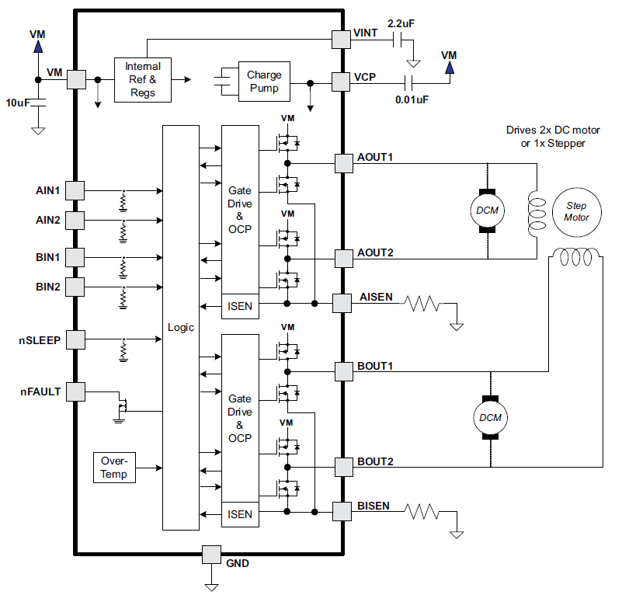
Arm Motor Controllers
DRV8833PWPR Dual bridge motor driver
Supply voltage: up to 11 V per channel
Supply current: up to 1.5A per channel
Over-current, under-voltage, over-temperature protection and Energy savings mode
PWM/Digital Control
Footprint: ~.25 inch²
Price: ~$1.50

Slide 20
Com Systems

Slide 21
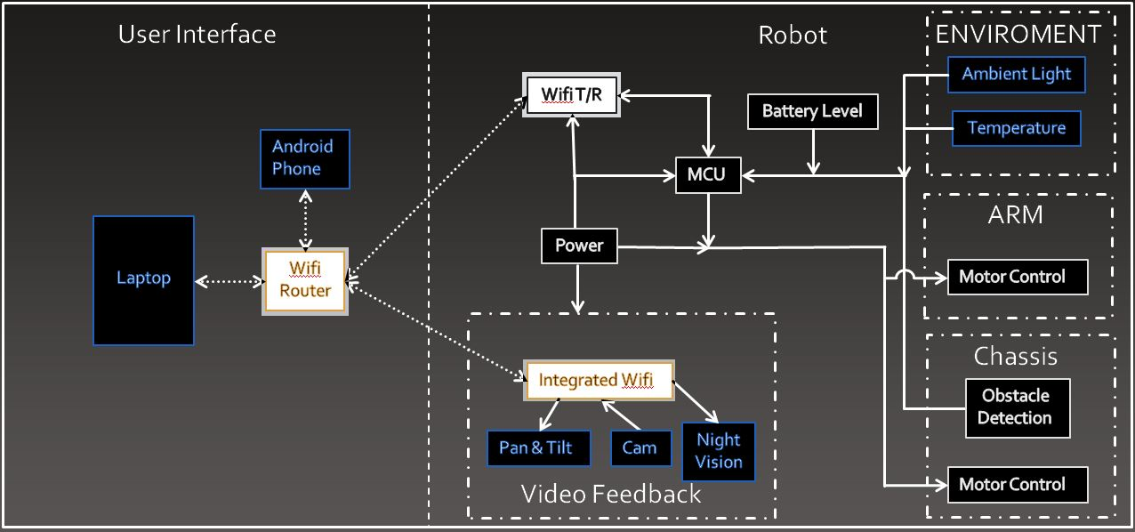
Com Systems

Slide 22
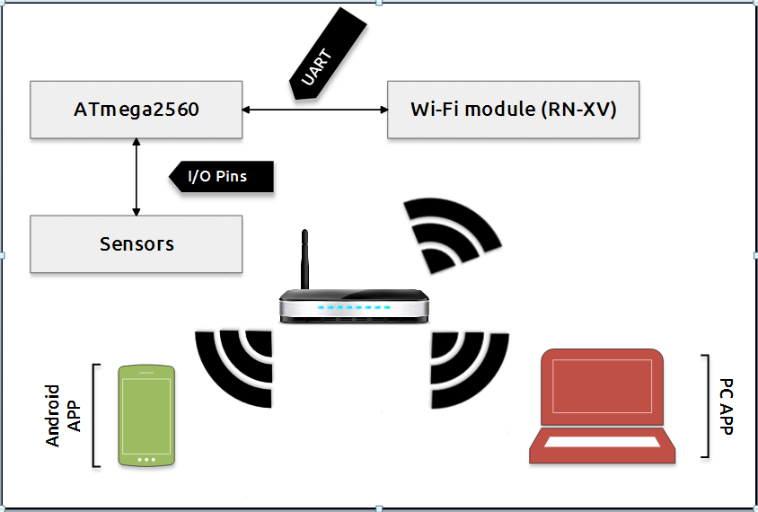
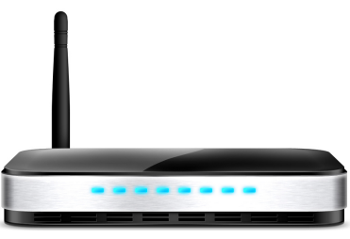
Communications

Slide 23
Communication Technology
 | Bluetooth 2.1 | ZigBee S2 | Wi-Fi
Peak Range (m) | 30 | 70 | 100
Frequency (GHz) | 2.4 | 2.4 | 2.4
Bandwidth (Mbps) | 2.1 | 0.25 | 11
Encryption | Yes | Yes | Yes
Interface | UART/USB | UART/USB | UART/SPI/USB
Cost ($) | 29.91 | 21 | 35

Slide 24
Communication Device
Wi-Fi Module | Bluegiga Technologies | Texas Instruments | Roving Networks
Model | WF111-A | CC3000MOD | RN171XVW-I/RM
Protocol (802.11) | b/g/n | b/g | b/g
Max Data Rate (Mbps) | 72.2 | 54 | 54
Interface | UART/USB/CSPI | SPI | UART
Antenna Type | Integrated | U.FL | Wire
Transmit Power (dBm) | 12 | 16 | 17
Security | WPA, WPA2, WEP, CCMP, TKIP, WPS | WEP, WPA, WPA2 | WEP, WPA, WPA2
Mounting | Surface Mount | Surface Mount | Through Hole
Cost ($) | 28.16 | 23.56 | 37.48

Slide 25
Protocol

Slide 26
Video Feed

Slide 27
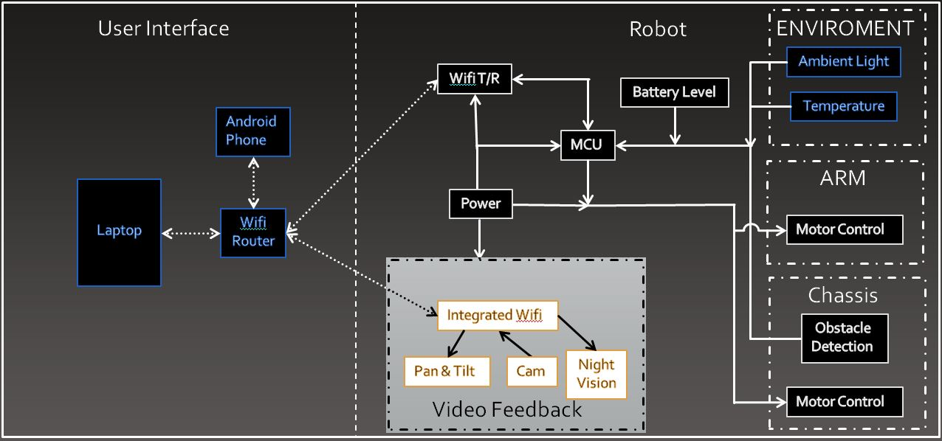
Video Feed

Slide 28
Camera
Make | HackHD SEN-11418 | Foscam FI8910W | D-Link DCS-932L
NightVision | No | Yes | No
Resolution | 1920 * 1080 | 640 * 480 | 640 * 480
FPS | 30 | 30 | 20
Microphone | No | Yes | No
Encoding | H.264 | MJPEG | MJPEG
Video Output | Composite | MJPEG Stream | MJPEG Stream
Pan / Tilt | No | 300° / 120° | No
Cost ($) | 159.95 | 65.00 | 69.70

Slide 29
Environment Peripherals

Slide 30
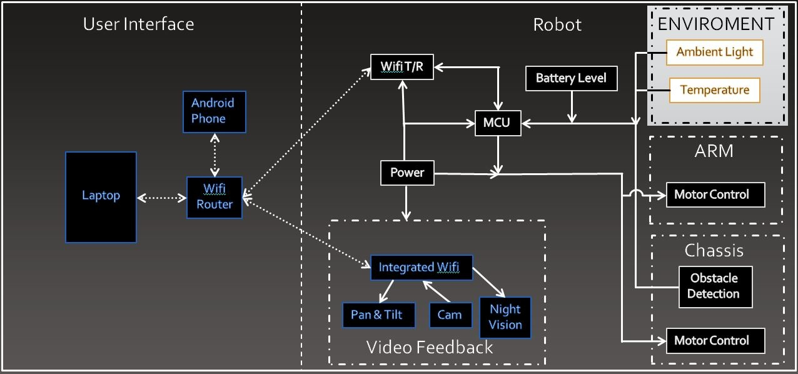
Environment Peripherals

Slide 31
Ambient Light Sensors
Make | Vishay | SEN-09088 Photo Cell | ROHM Semiconductors
Part # | TEPT4400 | 09088 | BH1603FVC-TR
Peak Wavelength (nm) | 570 | 550 | 560
Operating Temp (°C) | -40 to +85 | -30 to +70 | -40 to +85
Mounting | Through Hole | Through Hole | Surface Mount
Peak Supply Voltage (V) | 6 | 150 | 5.5
Power Dissipation (mW) | 100 | 100 | 260
Cost ($) | 0.62 | 1.50 | 1.15

Slide 32
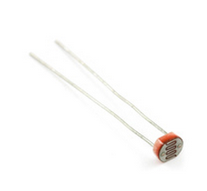
Interfacing Light Sensor
Output voltage is directly proportional to illuminance:
0V = 0 lux (dark)
2.5V = 1000 lux (typical indoor lighting)
5V = 10000 lux (daylight on a sunny day)

Slide 33
Temperature Sensors
Make | Dallas Semiconductor | Analog Devices | Maxim Integrated
Base Part | DS18B20 | TMP36 | DS18B20
Max Voltage Supply (V) | 5.5 | 5.5 | 5.5
Min Temperature (°C) | -55 | -40 | -55
Max Temperature (°C) | +125 | +125 | +125
Accuracy (°C) | 0.5 | 2 | 0.6
Output | digital | analog | digital
Cost ($) | 4.25 | 1.5 | 9.95

Slide 34
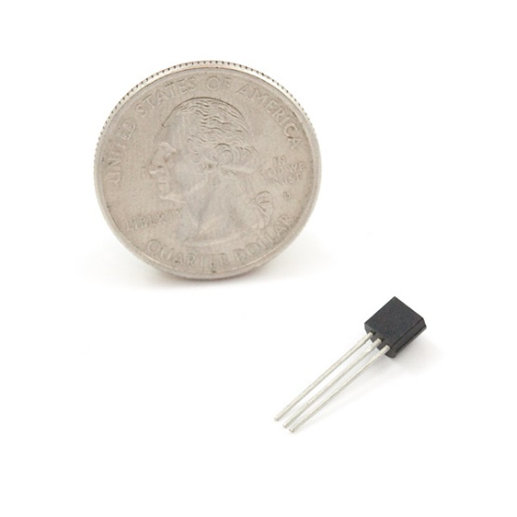
Interfacing Temperature Sensor
One digital line for input/output
Temperature reading corresponds to value in Temperature Register:
    0° C = 0x0000
125° C = 0x07D0
hex_value / 16 = temperature in °C
Image by Sparkfun.com under Creative Commons

Slide 35
ATmega2560 Code

Slide 36
Java Code

Slide 37
Navigation Example

Slide 38
Light Check Example

Slide 39
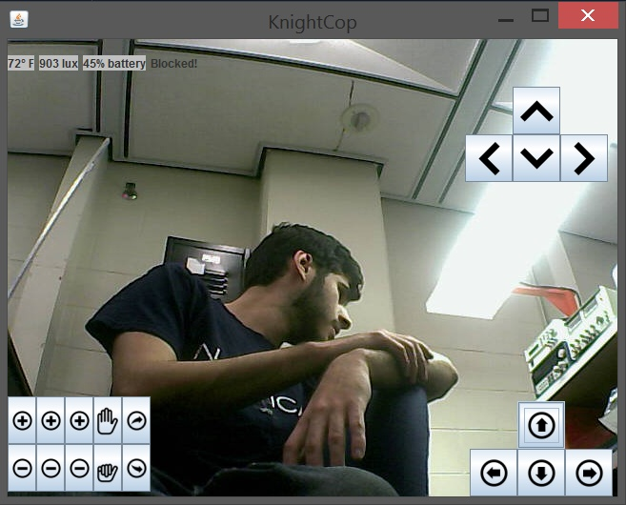
PC UI
image from Wikipedia under CC

Slide 40
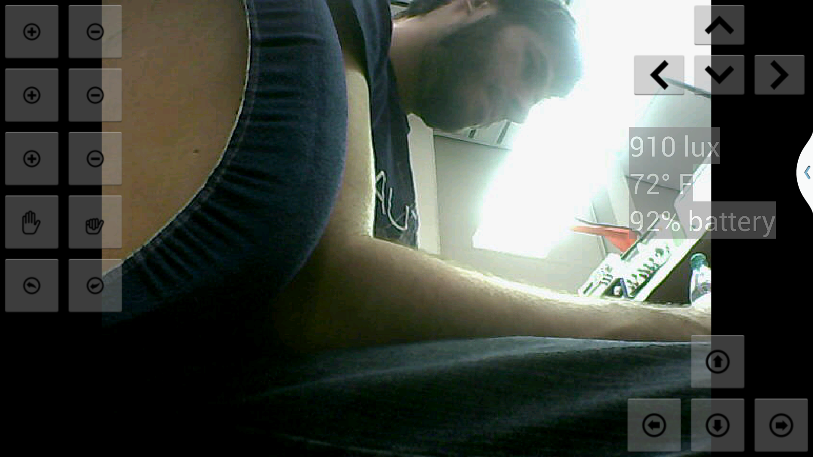
Android UI

Slide 41
Work Distribution
 | Elean | Nitin
Chassis Design and Construction | X
Communications |  | X
PC + Android Apps |  | X
Obstacle Detection | X | X
Microcontroller Programming | X | X
PCB Design | X
Power | X

Slide 42
Spending
Part | Manufacturer | Quantity | Unit Price | Net Price
Ultrasonic Sensors | Maxbotix | 4 | $25.95 | $103.80
Potentiometer | 中国制造 | 1 | $1.95 | $1.95
Drive Motors | CIM | 4 | $25.00 | $100.00
Manipulator | OWI Robots | 1 | $45.00 | $45.00
Arm Motor Controllers | Texas Instruments | 3 | $2.00 | $6.00
Drive Motor Controllers | Vex Robotics | 4 | $69.99 | Donated
Micro Switch | Sparkfun | 2 | $0.95 | $1.50
RN-XV Wi-Fi Module | Roving Networks | 1 | $34.94 | $34.94
Temperature Sensor | Maxim Integrated | 1 | $4.25 | $4.25
Ambient Light Sensor | Sharp Electronics | 1 | $0.81 | $0.81
IP Camera | Foscam | 1 | $65.00 | $65.00
AVR ISP | Atmel | 1 | $34.00 | $34.00
Arduino Mega 2560 | Arduino | 1 | $45.95 | $45.95
ATmega2560 | Atmel | 1 | $18.00 | Sampled
MiniBoards | ExpressPCB | 3 | $33.00 | $99.00
72’’ Aluminium Angle | Vex Robotics | 3 | $29.95 | $89.85
Sensor Brackets | Vex Robotics | -- | -- | 50.00
Trimpot 10K with Knob | Sparkfun | 4 | $0.95 | $3.80
ToughBox Nano 500 Hex Shaft | AndyMark | 4 | $78.00 | Donated
6” Plaction Wheel w/ Tread | AndyMark | 4 | $29.00 | Donated
Hex Wheel Hub | AndyMark | 4 | $10.00 | Donated
Misc Mechanical Parts | -- | -- | -- | 50.00
Misc Electrical Supplies (Resistors, Capacitors, Wires etc) | -- | -- | -- | 50.00
TOTAL |  |  |  | $785.85

Slide 43

Questions?

